Slide 1
Automated Door LOCK/Unlock System
DHARSHINI R
SANDHIYA DEVI B
SHRI SUBIKSHA S T

Slide 2
AIM
Developing a system to ensure secure and controlled access to a door using Bluetooth technology.
Providing users with a convenient and intuitive means of unlocking the door using their smartphone, eliminating the need for traditional keys.
Enabling remote door unlocking functionality via a mobile app, offering users the flexibility to grant access without keys.

Slide 3
SCOPE OF THE PROJECT
The purpose of the door locking system project is to develop a cutting-edge solution that allows users to control door access from a nearby distance.
This project aims to offer an alternative to traditional physical keys, enhancing security measures while providing flexibility and convenience for users to manage access control through their smartphones.
This project also ensures the security by robust authentication measures.

Slide 4
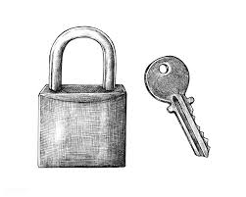
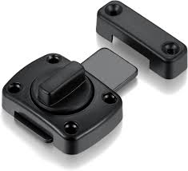
APPLICATIONS
Homeowners can use Bluetooth-enabled door locks to securely unlock their front doors using their smartphones instead of traditional keys.
Businesses can implement Bluetooth door locks for secure access control in office buildings, allowing employees to unlock doors using their smartphones. Administrators can easily manage access permissions and track entry logs.
Hotels can deploy Bluetooth door locks for guest rooms, providing guests with keyless entry via a mobile app. This streamlines the check-in process and enhances the guest experience.
Landlords and property managers can use it to manage access to rental properties remotely. They can grant temporary access to tenants or service providers and monitor entry logs in real-time.

Slide 5
PROPOSED METHOD
Implementing a user-friendly interface with a prominent "Unlock" option. (app)
Establishing a secure and reliable connection between the app and Arduino via Bluetooth module.
Ensuring user authentication before allowing door unlock commands.
Transmitting unlock commands securely to Arduino to prevent unauthorized access.
Arduino must accurately receive and process unlock commands to activate the door unlock mechanism.
Providing real-time feedback to the user about the door unlocking status.

Slide 6
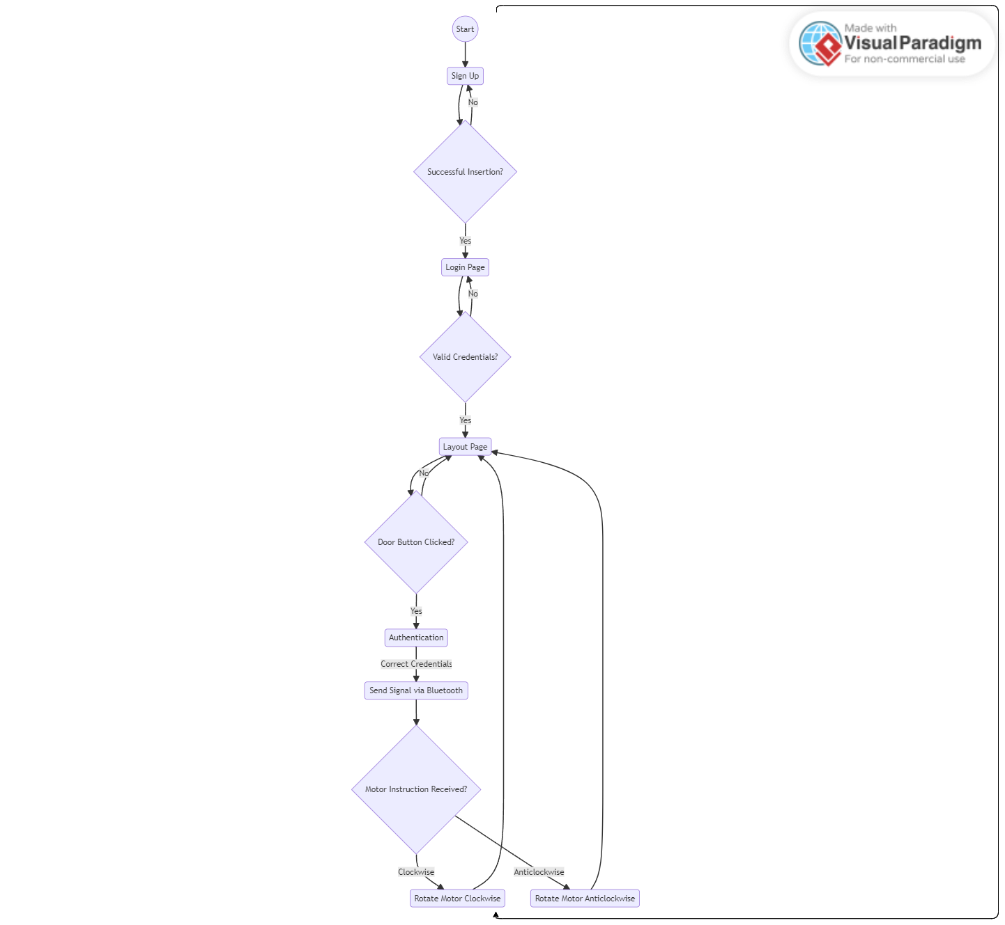
ACTIVITY DIAGRAM

Slide 7
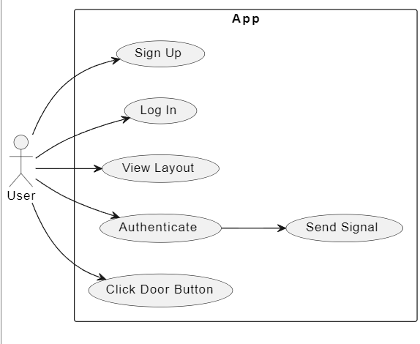
USECASE DIAGRAM

Slide 8
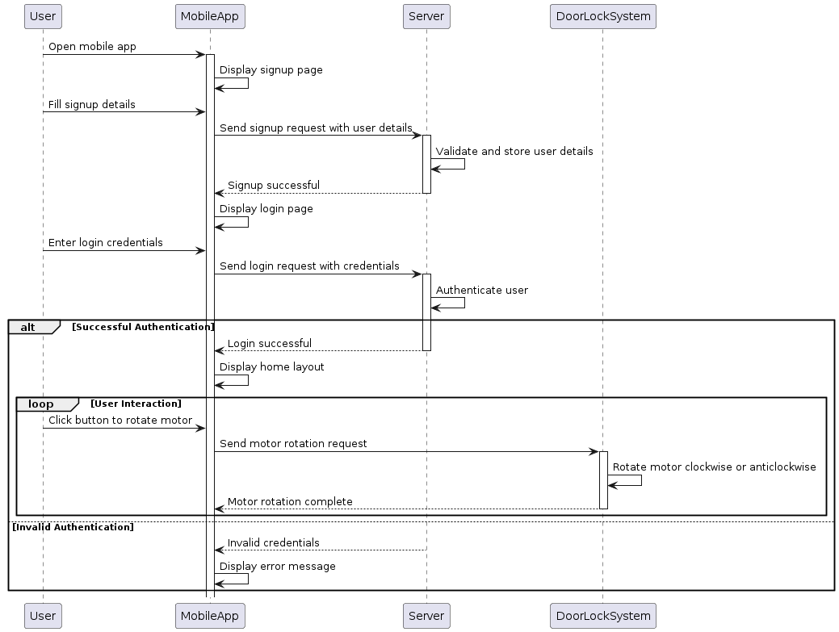
SEQUENCE DIAGRAM

Slide 9
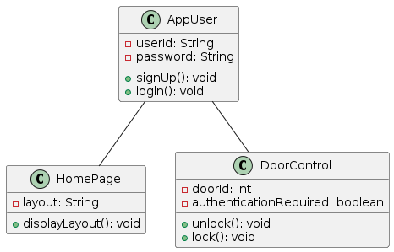
CLASS DIAGRAM
USER
DOOR CONTROL
HOME PAGE

Slide 10
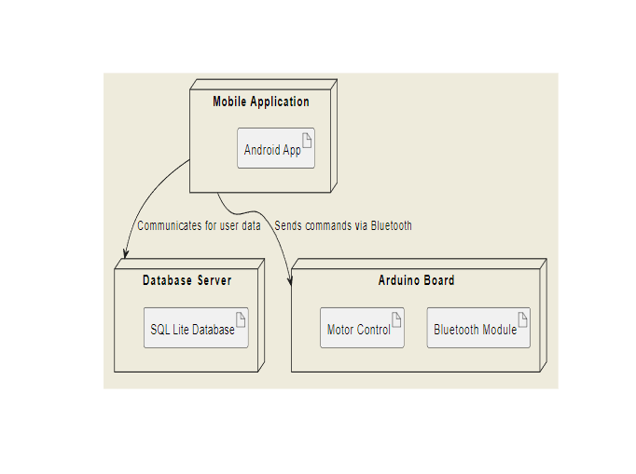
DEPLOYMENT DIAGRAM

Slide 11
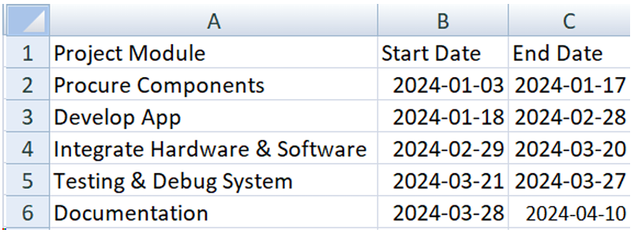
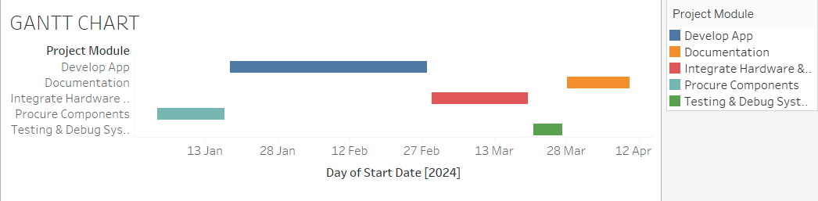
GANTT CHART

Slide 12
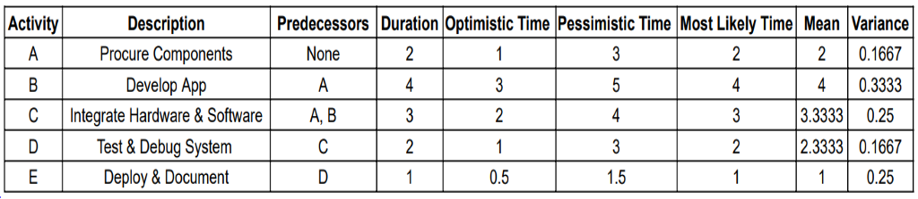
PERT CHART

Slide 13
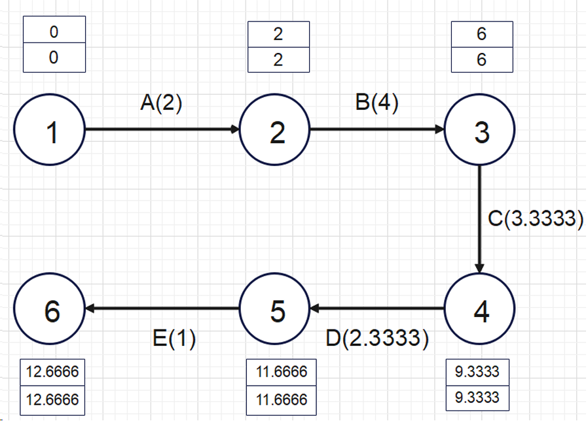
PERT CHART

Slide 14
Functional Requirements
User Registration:
The system should allow users to sign up by providing necessary details like username, password, and other relevant information.
User Authentication:
After registration, users should be able to log in using their credentials. The system should verify the user's identity before granting access to the home layout.
Home Layout Display:
Upon successful login, the system should display the home layout to the user. The layout should include buttons for each room's door.
Door Control:
Users should be able to click on the buttons corresponding to the doors they want to control. The system should prompt the user for authentication before allowing door control.
Motor Control:
Upon successful authentication, the system should send signals via Bluetooth to the Arduino Uno board to control the L293D motor. The motor should rotate either clockwise or anticlockwise based on the user's command.

Slide 15
NON FUNCTIONAL REQUIREMENTS
Security:
The system should ensure secure user authentication to prevent unauthorized access to the door control functionality. Data transmission between the mobile app and the Arduino board should be encrypted to prevent tampering.
Reliability:
The system should be reliable, ensuring that doors unlock and lock promptly upon user command. It should handle errors gracefully and provide informative error messages to users in case of failures.
Usability:
The mobile app interface should be user-friendly, with intuitive navigation and clear instructions. Buttons for door control should be easily accessible and identifiable within the home layout.
Performance:
The system should have low latency in transmitting signals between the mobile app and the Arduino board. Motor response time should be minimal to provide a seamless user experience.
Scalability:
The system should be scalable to accommodate additional doors or rooms in the future. It should handle a growing number of users without compromising performance or security.

Slide 16
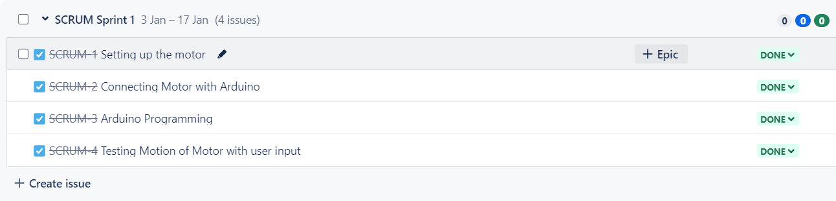
SPRINT BACKLOGS

Slide 17
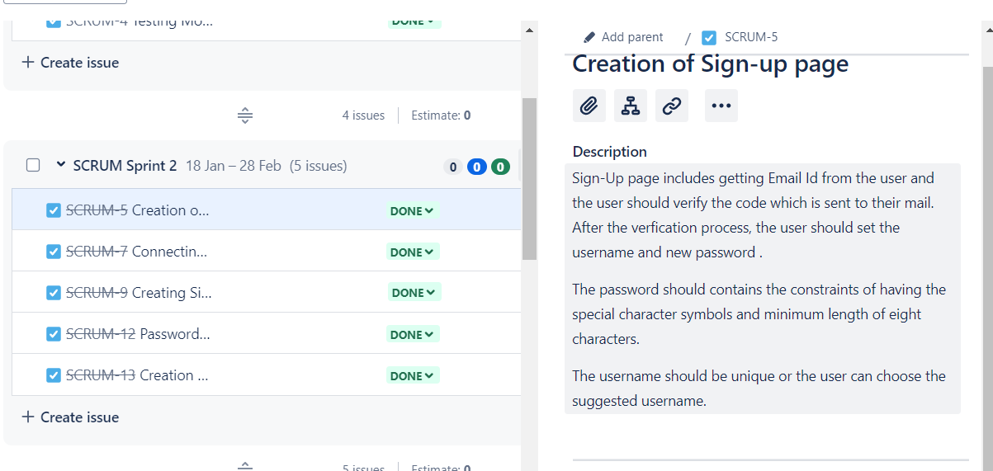

Slide 18
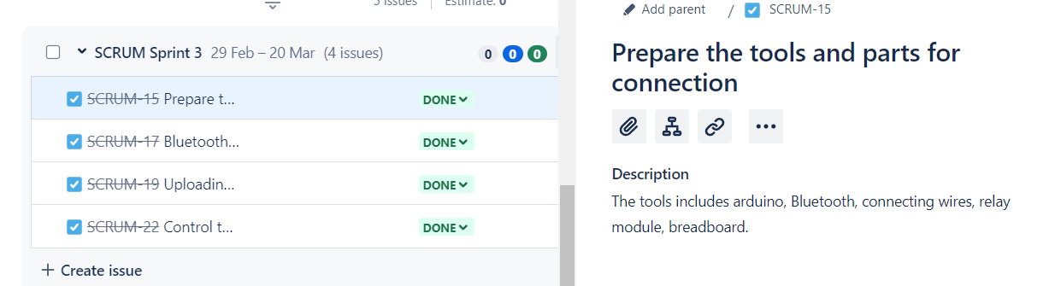

Slide 19
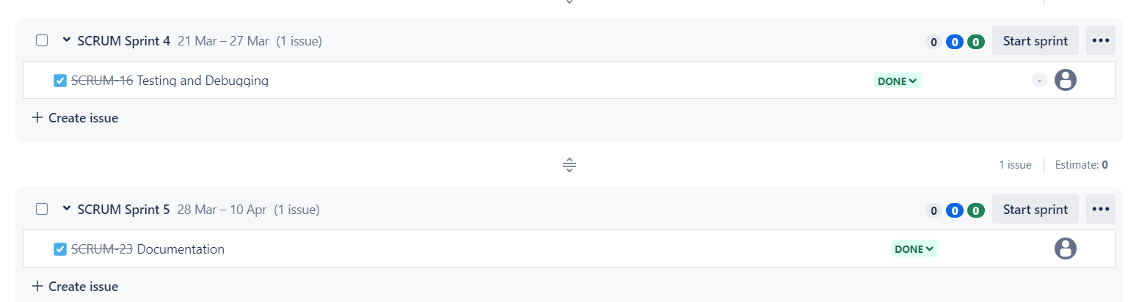

Slide 20
HARDWARE SETUP
COMPONENTS REQUIRED
ARDUINO UNO BOARD
BLUETOOTH MODULE
MOTOR DRIVER L293D
12 V ADAPTER
MOTORS

Slide 21
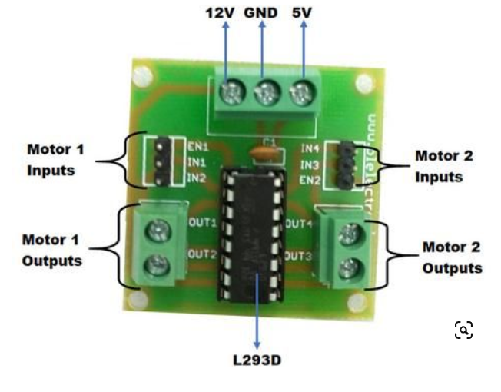
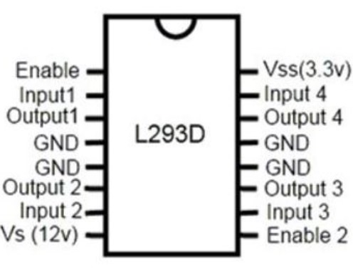
PIN DIAGRAM

Slide 22
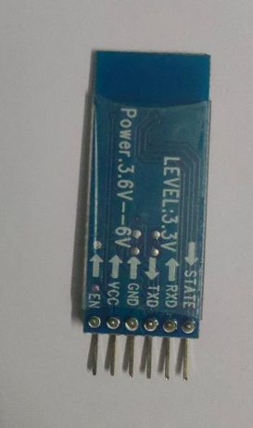
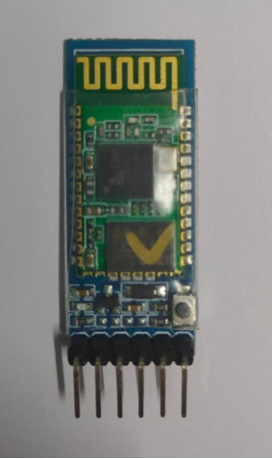
BLUETOOTH MODULE

Slide 23
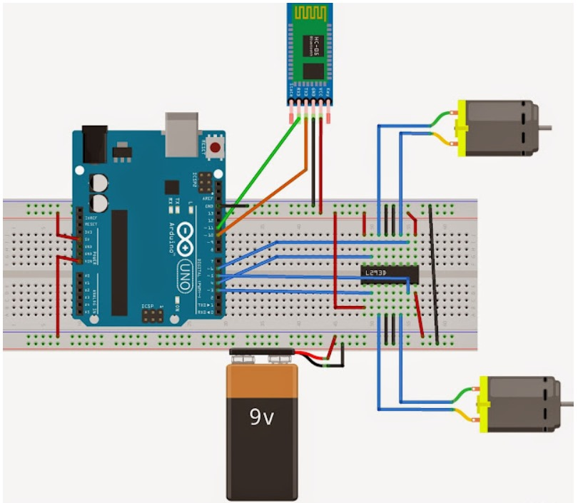
CIRCUIT DIAGRAM

Slide 24
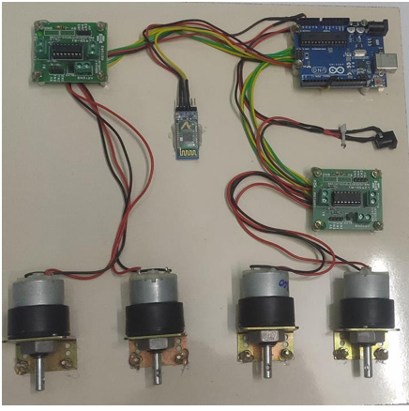

Slide 25
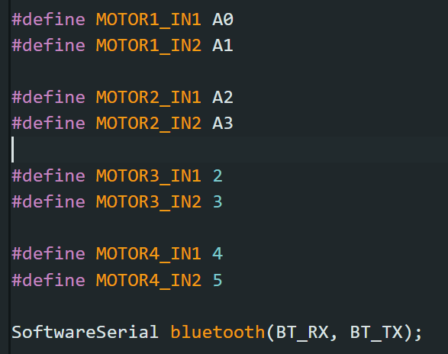
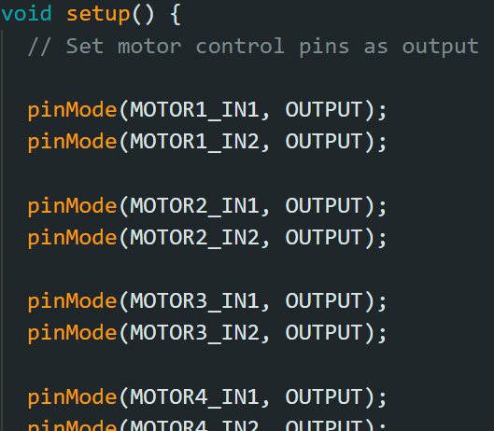
ARDUINO IMPLEMENTATION

Slide 26
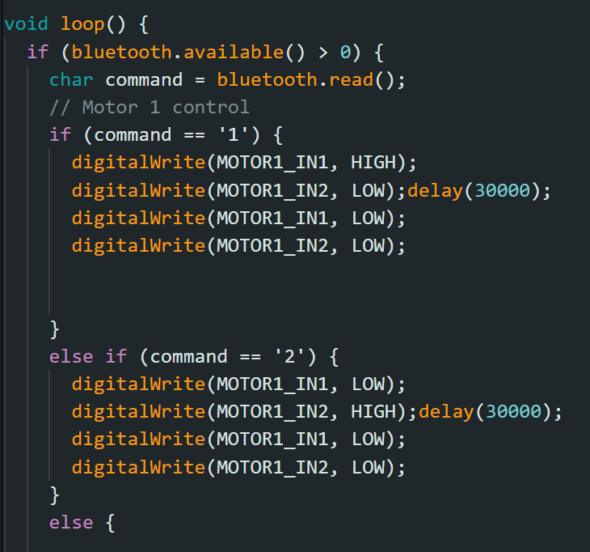
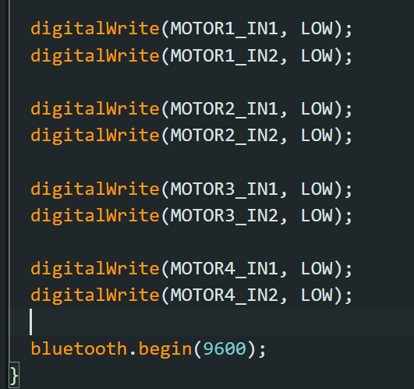

Slide 27
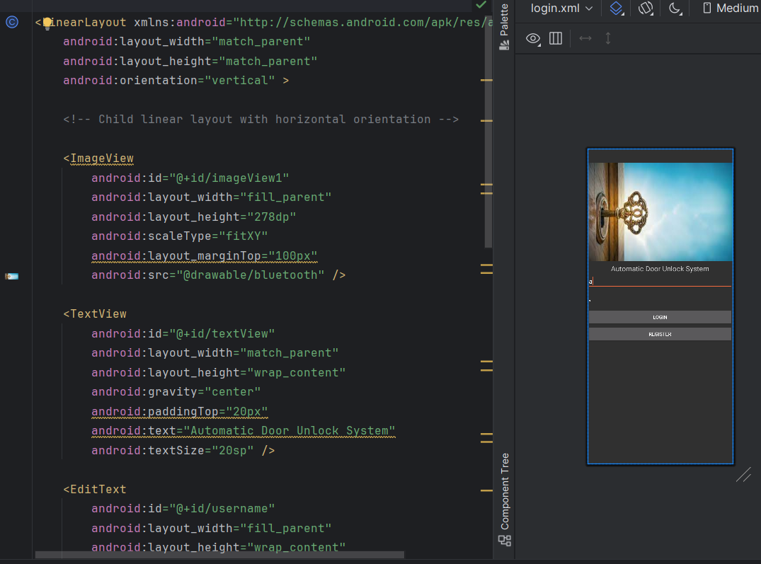

Slide 28
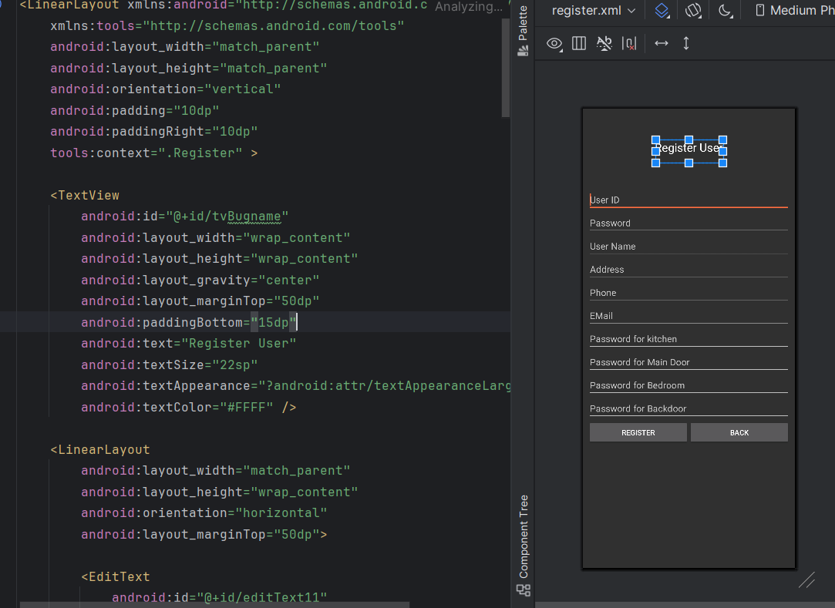

Slide 29
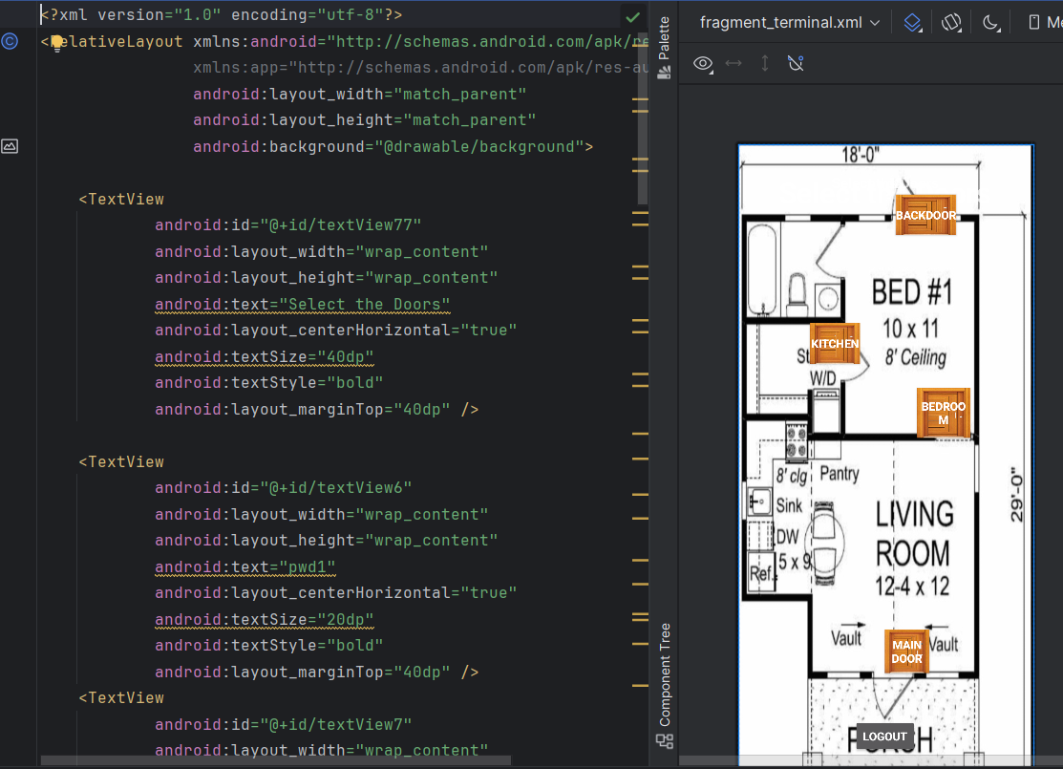

Slide 30
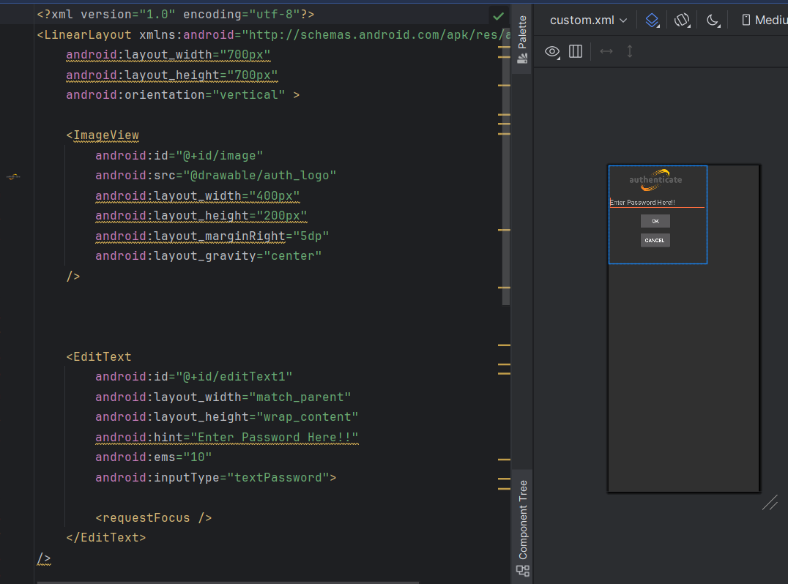

Slide 31
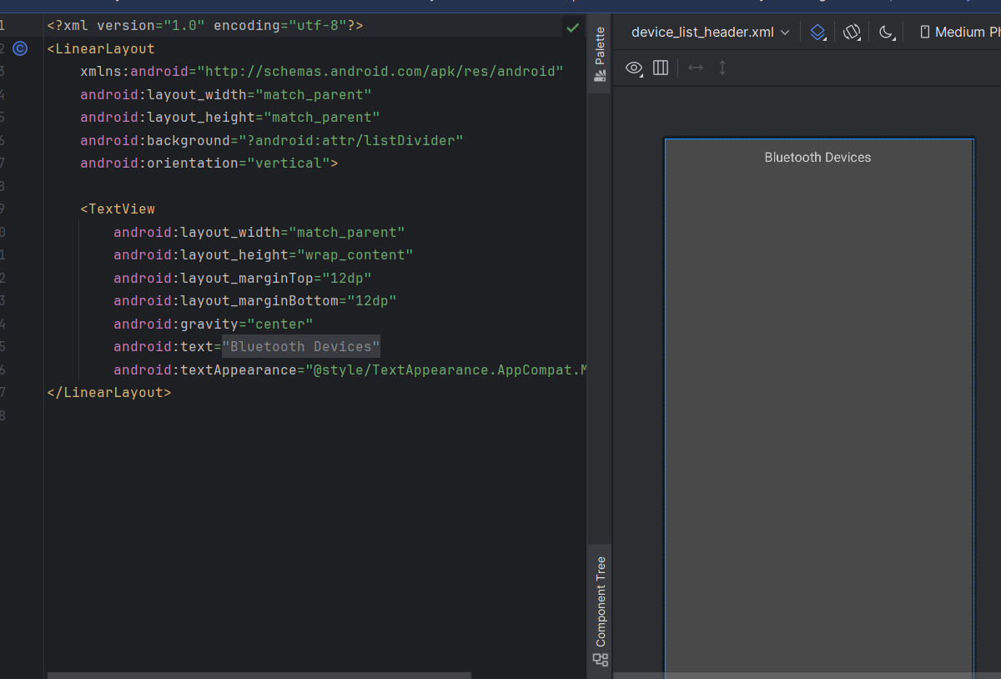
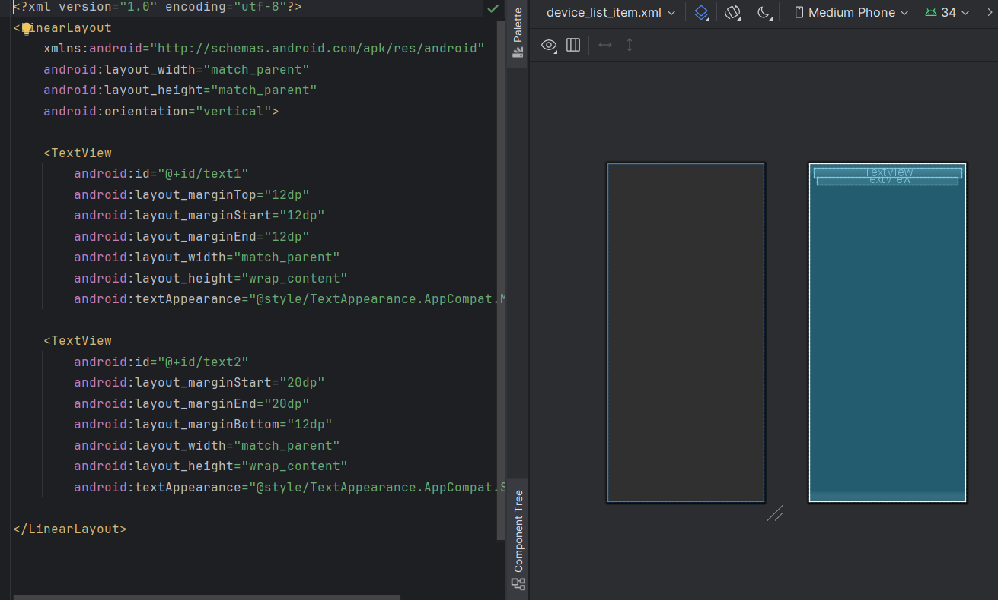

Slide 32
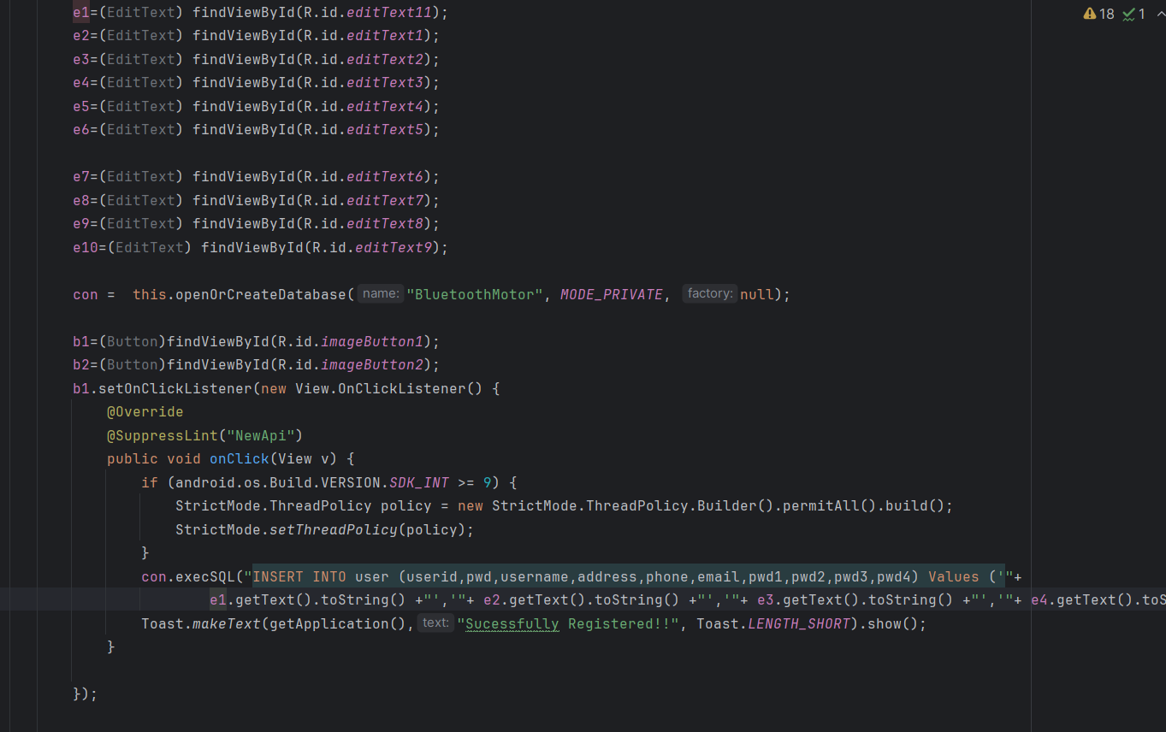

Slide 33
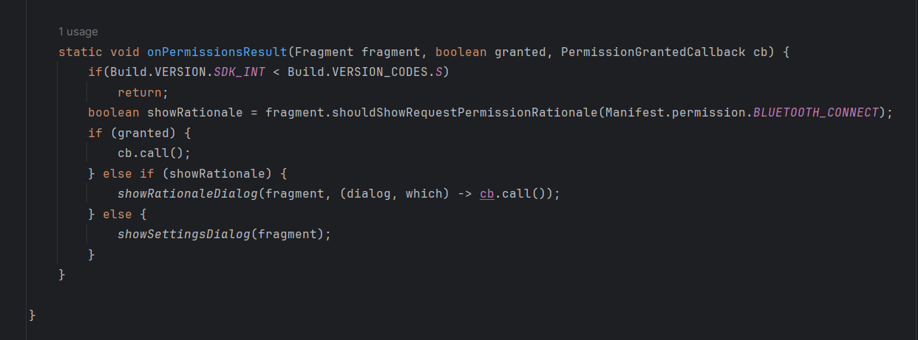

Slide 34
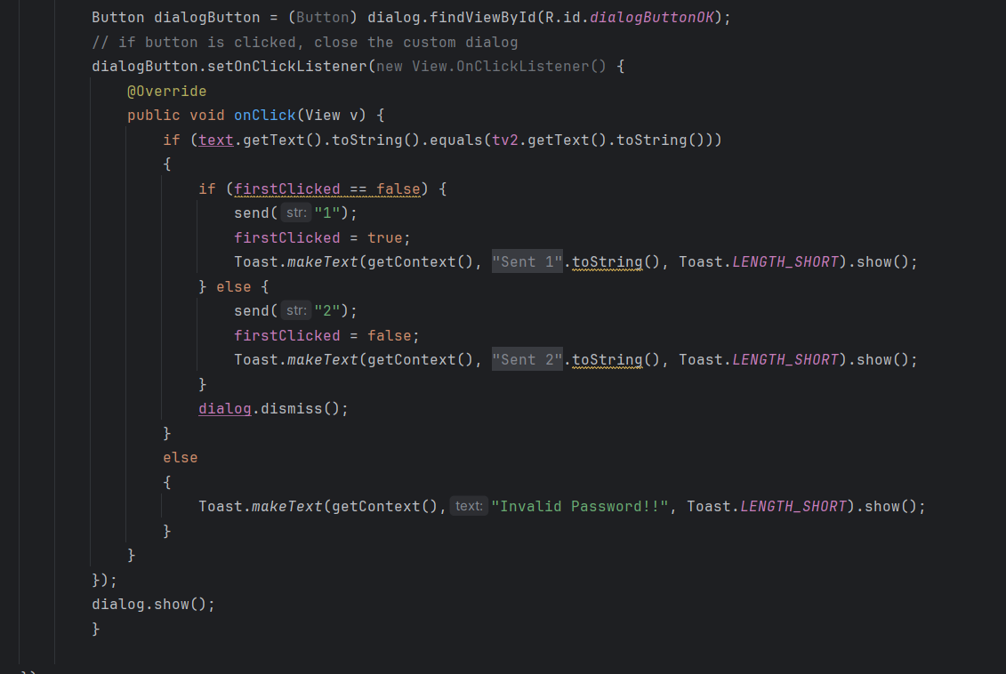

Slide 35
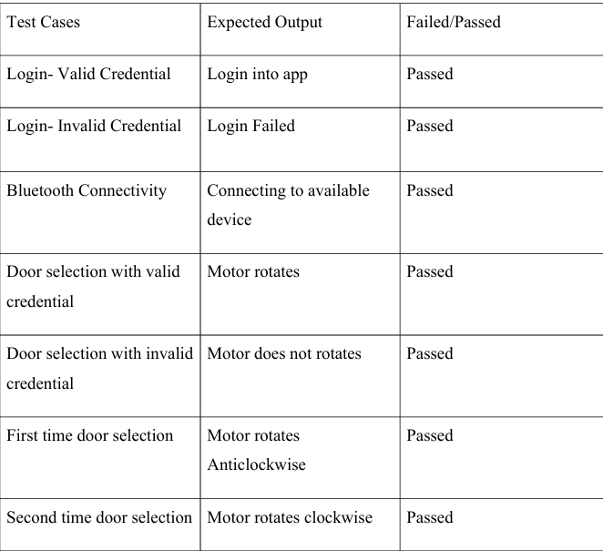
BLACKBOX TESTING

Slide 36
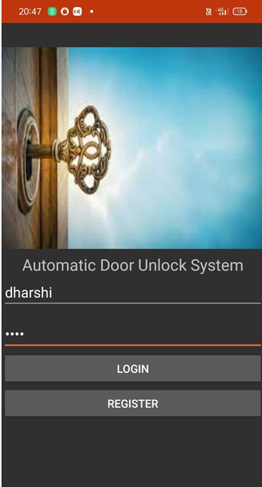
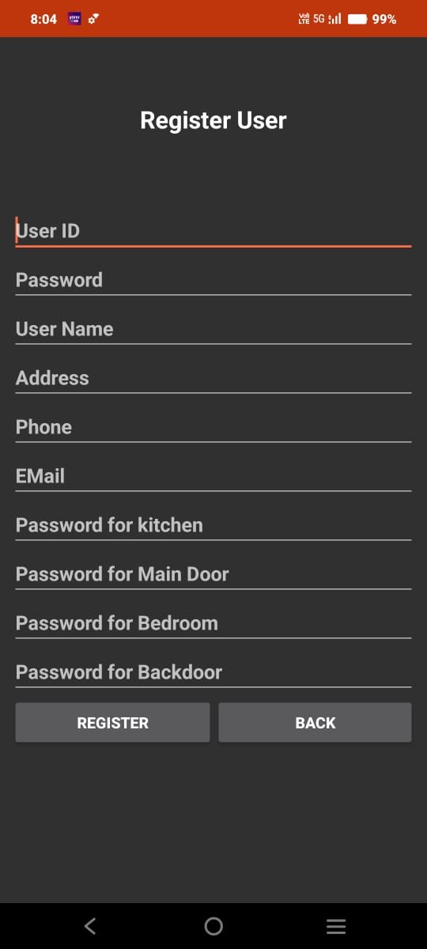
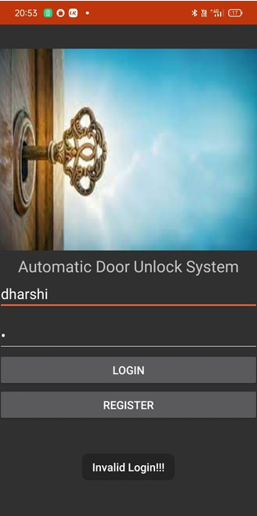

Slide 37
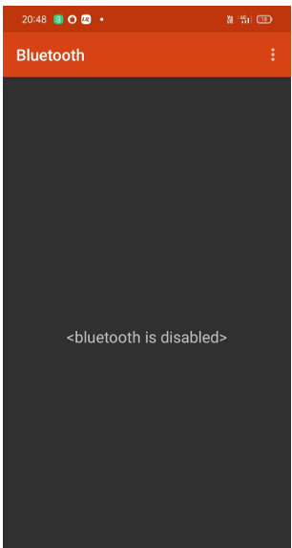
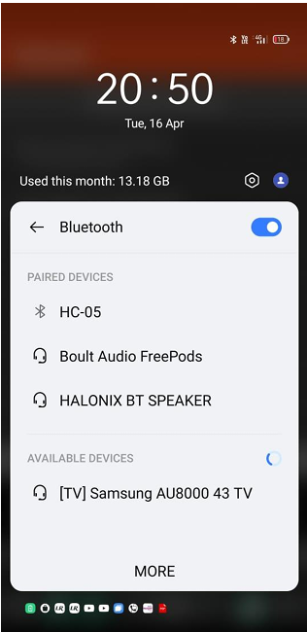
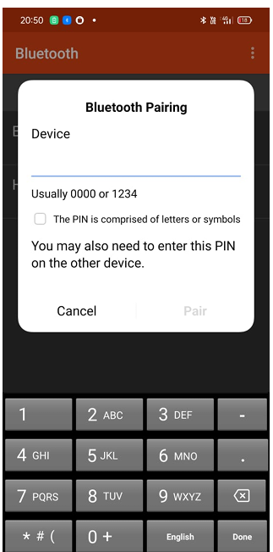
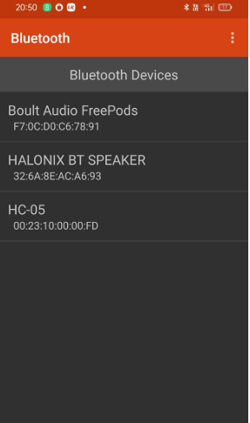

Slide 38
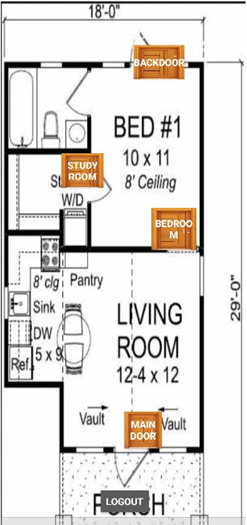
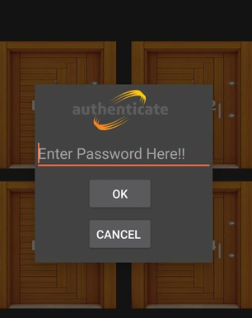

Slide 39
THANK YOU

